Slide 1

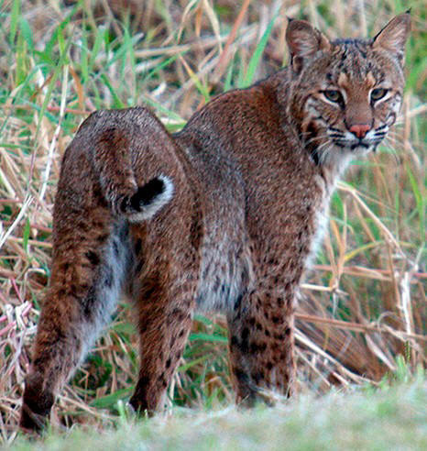
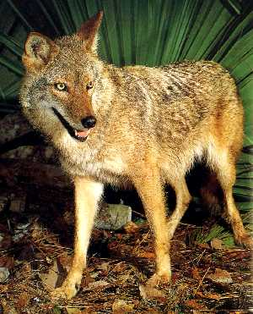
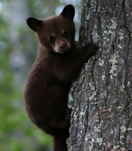
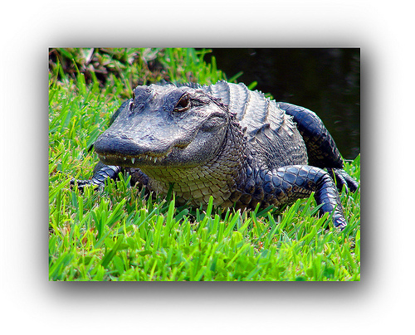
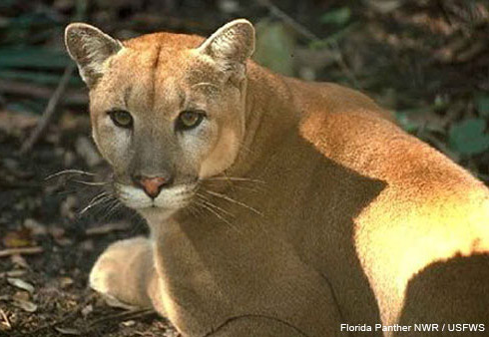
Do You Know Florida’s Predators?
Quiz Time!

Slide 2
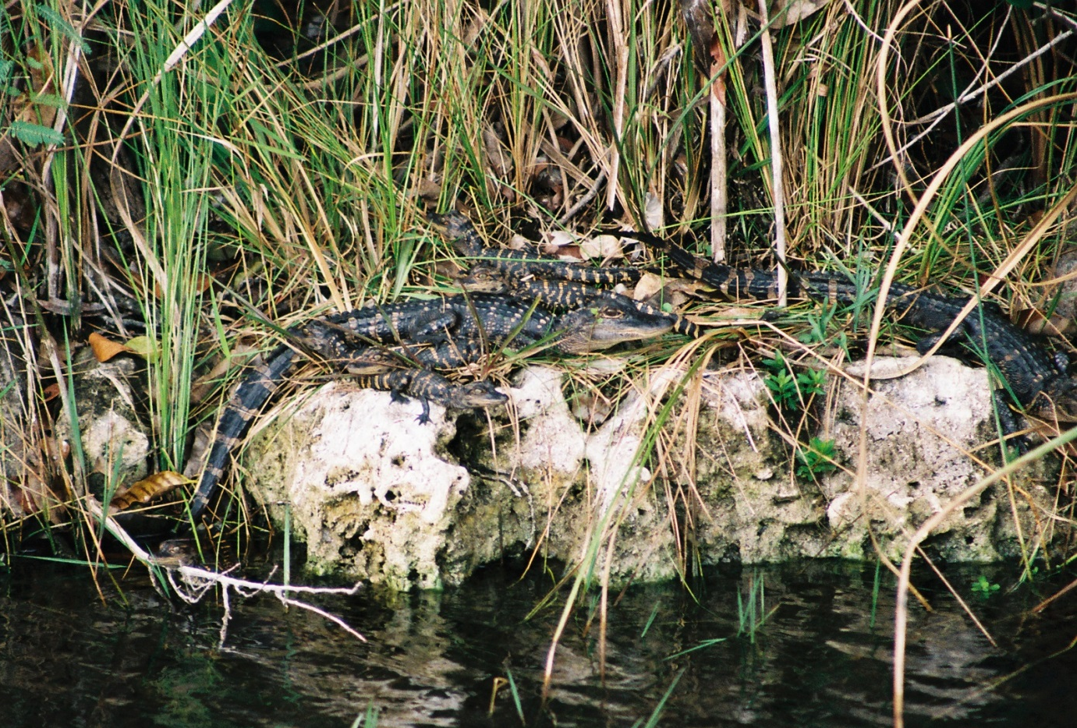
How much do you know about the predators of Florida?

Slide 3
Question #1
True or False?
A mountain lion, a cougar, a puma, and a panther are all different species of cat.

Slide 4
Question #2
True or False?
The Florida black bear eats mostly meat.

Slide 5
Question #3
True or False?
Coyotes usually hunt in packs.

Slide 6
Question #4
True or False?
Bobcats travel mostly during nighttime hours and can walk up to a mile each night.

Slide 7
Question #5
True or False?
Alligators are naturally afraid of humans.

Slide 8
Question #6
True or False?
A Florida panther track doesn’t usually show claw marks.

Slide 9
Question #7
True or False?
Florida black bears don’t climb trees.

Slide 10
Question #8
True or False?
Coyotes are native to Florida.

Slide 11
Question #9
True or False?
Bobcats and panthers are most active during the day.

Slide 12
Question #10
True or False?
Alligators can hold their breath to stay under water for an hour or more.

Slide 13
Question #11
True or False?
Florida panthers hunt by jumping out of trees onto their prey.

Slide 14
Question #12
True or False?
Florida black bears have a better sense of smell than a bloodhound.

Slide 15
Question #13
True or False?
Coyotes will eat carrion (dead animal meat).

Slide 16
Question #14
True or False?
Bobcats can hunt and take down an adult deer.

Slide 17
Question #15
True or False?
Alligators and crocodiles can both be found in South Florida.

Slide 18
Question #16
True or False?
Florida panthers roar before they attack.

Slide 19
Question #17
True or False?
Panthers and bears are naturally curious about humans, and it is normal for them to wander past and watch us.

Slide 20
Question #18
True or False?
Pumas, including Florida panthers and mountain lions in the West, kill more people than deer do in North America.

Slide 21
Question #19
True or False?
You should run zigzag if you come across an alligator.

Slide 22
Question #20
True or False?
Florida panthers eat more frequently than large alligators.

Slide 23
Do You Know Florida’s Predators?
Answers

Slide 24
Question #1
True or False?
A mountain lion, a cougar, a puma, and a panther are all different species of cat.
False. All are different subspecies of the species Puma concolor.

Slide 25
Question #2
True or False?
The Florida black bear eats mostly meat.
False. 80% of a Florida black bear’s diet is from plants like berries, acorns, and heart of Cabbage palm.

Slide 26
Question #3
True or False?
Coyotes usually hunt in packs.
False. Coyotes occasionally hunt in packs, but usually hunt alone or in pairs.

Slide 27
Question #4
True or False?
Bobcats travel mostly during nighttime hours and can walk up to a mile each night.
False. Bobcats travel between 2 and 7 miles each night.

Slide 28
Question #5
True or False?
Alligators are naturally afraid of humans.
True. Alligators lose their fear of humans and can become dangerous if people feed them.

Slide 29
Question #6
True or False?
A Florida panther track doesn’t usually show claw marks.
False. Panthers, like all cats, can retract their claws to walk quietly.

Slide 30
Question #7
True or False?
Florida black bears don’t climb trees.
False. Florida black bears are excellent climbers. A mother bear will send her cubs up a tree to avoid danger.

Slide 31
Question #8
True or False?
Coyotes are native to Florida.
False. Coyotes are native to the SW United States. They gradually moved east as other predators were hunted nearly to extinction. Coyotes were first documented in FL in 1925.

Slide 32
Question #9
True or False?
Bobcats and panthers are most active during the day.
False. Both bobcats and panthers are most active between dusk and dawn.

Slide 33
Question #10
True or False?
Alligators can hold their breath to stay under water for an hour or more.
True. Although they cannot breathe underwater, alligators like to hide and rest beneath the surface.

Slide 34
Question #11
True or False?
Florida panthers hunt by jumping out of trees onto their prey.
False. Panthers hunt by silently stalking their prey from the ground until they are close enough to sprint and pounce on it.

Slide 35
Question #12
True or False?
Florida black bears have a better sense of smell than a bloodhound.
True. Scientists have determined that a black bear can smell 7 times better than a bloodhound and can detect food from several miles away.

Slide 36
Question #13
True or False?
Coyotes will eat carrion (dead animal meat).
True. Coyotes are opportunistic feeders and will eat just about anything. Animals that eat carrion are called “scavengers”.

Slide 37
Question #14
True or False?
Bobcats can hunt and take down an adult deer.
True. Even though bobcats only weigh between 15-30 lbs., they have been known to take down a 150 lb. deer.

Slide 38
Question #15
True or False?
Alligators and crocodiles can both be found in South Florida.
True. South Florida is the only place in the world where alligators and crocodiles live side-by-side.

Slide 39
Question #16
True or False?
Florida panthers roar before they attack.
False. Panthers try to be as quiet as possible when hunting. Although they make sounds to communicate with each other, a panther cannot roar like a lion.

Slide 40
Question #17
True or False?
Panthers and bears are naturally curious about humans, and it is normal for them to wander past and watch us.
True. Panthers and bears are smart and inquisitive, and this is normal.

Slide 41
Question #18
True or False?
Pumas, including Florida panthers and mountain lions in the West, kill more people than deer do in North America.
False. There are no documented attacks from a Florida panther on a human, and mountain lion attacks are very rare. Deer kill many more people because they run in front of cars and cause accidents.

Slide 42
Question #19
True or False?
You should run zigzag if you come across an alligator.
False. Alligators are very unlikely to run after a human because we are not suitable prey. If an alligator did come towards you aggressively, run fast and straight because it will not go very far.

Slide 43
Question #20
True or False?
Florida panthers eat many times more food than large alligators.
True. Panthers are warm-blooded and need the equivalent of one deer every week. Alligators are cold blooded and only need a fraction of this. They don’t even feed if the temperature is below 70 F!

Slide 44

Were you surprised by any of the answers to the quiz?

Slide 45

Why do you think so many people have misconceptions about predators?

Slide 46
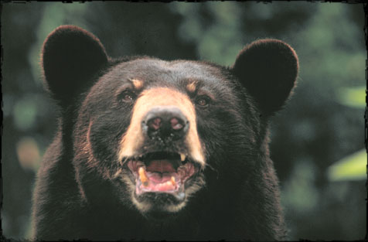
Do you feel any differently about the predators of Florida after learning more information about them? How so?

